Slide 1


How to improve our delivery
Save money & time with automation superpowers!
CI/CD
By: Omnia Maher

Slide 2
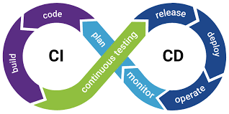
What is CI/CD ?
continuous integration and continuous delivery. allows organizations to ship software quickly and efficiently. CI/CD facilitates an effective process for getting products to market faster than ever before, continuously delivering code into production, and ensuring an ongoing flow of new features and bug fixes via the most efficient delivery method

Slide 3
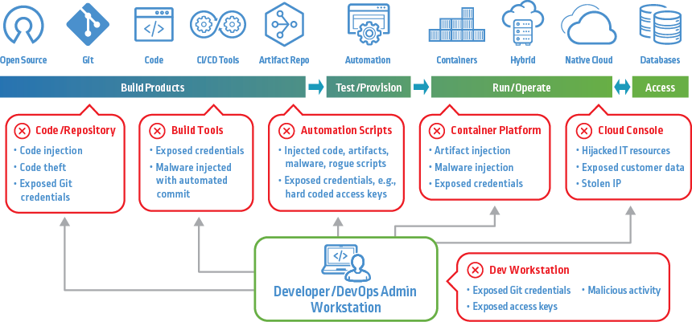

Slide 4
Continuous Integration (CI)
Continuous integration means that developers frequently merge their code changes to a shared repository. It’s an automated process that allows multiple developers to contribute software components to the same project without integration conflicts. CI involves automated testing whenever a software change is integrated into the repository.

Slide 5
CD?
CD can stand for either continuous delivery or continuous deployment. Both involve taking the code continuously integrated and getting it able to deploy to an environment either QA or production. Continuous deployment takes the process one step further and performs the actual deployment to an environment.

Slide 6
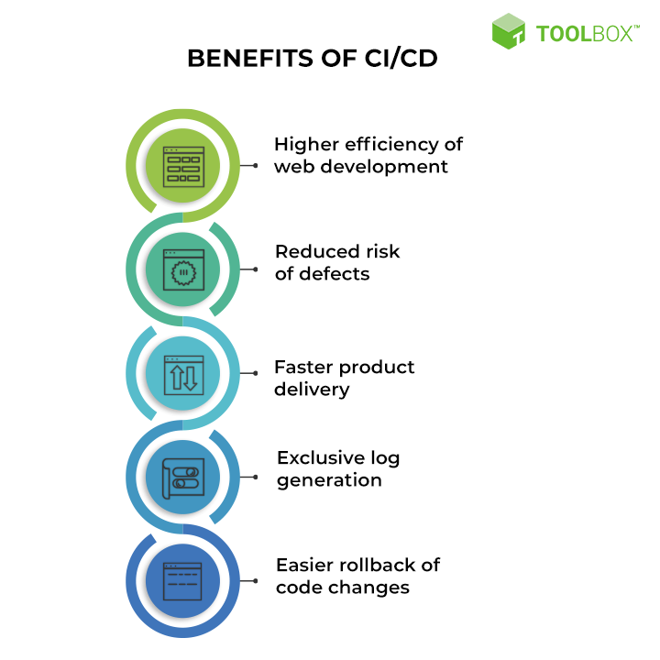
Benefits of CI/CD
Make Revenue
Faster and More Frequent Production Deployments ensures more
quicker releases. Removal of manual checks before deployment
means less time to market.
Protect Revenue
Automated smoke test reduces downtime due to deploy related
crash or a major bug.
Automated rollback due to a job failure mea ns
a fast undo from production to working state.

Slide 7
Benefits of CI/CD
Avoid Cost
Reduce Cost
Fail Fast

